Slide 1
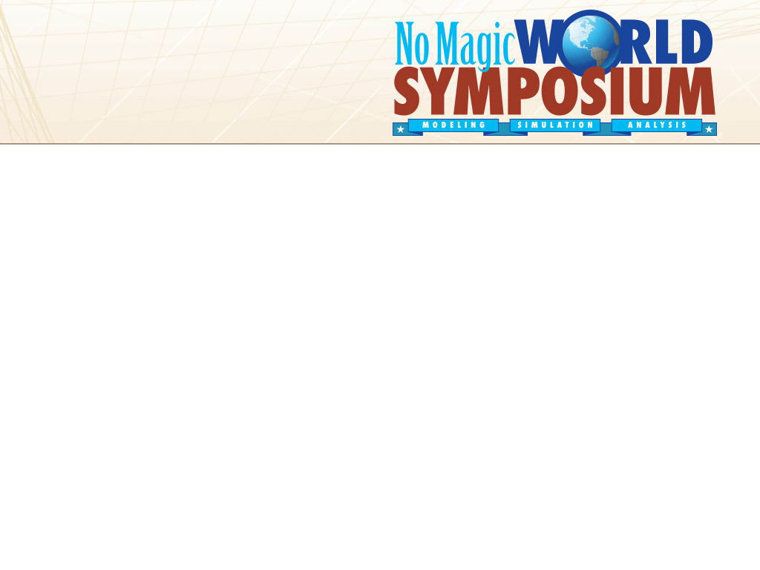

Five Years of Executable SysML With
Cameo Simulation Toolkit
A User Perspective - Insights and Outlook
Nerijus’ inventiveness and architectural vision
featuring Robert’s stubbornness and practical applications
Your Presentation Title Goes Here
June 8, 2015, Robert Karban
Jet Propulsion Laboratory, California Institute of Technology
© 2015 California Institute of Technology. Government sponsorship acknowledged.

Slide 2
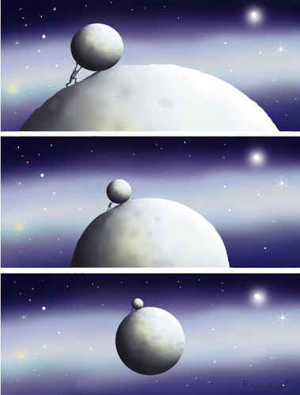
Outline
Background
Context and Goals
Modeling vs Drawing
Standards
The Beginnings
Applications and Highlights
Outlook
CST
CST
CST
MBSE
by marian kamensky

Slide 3
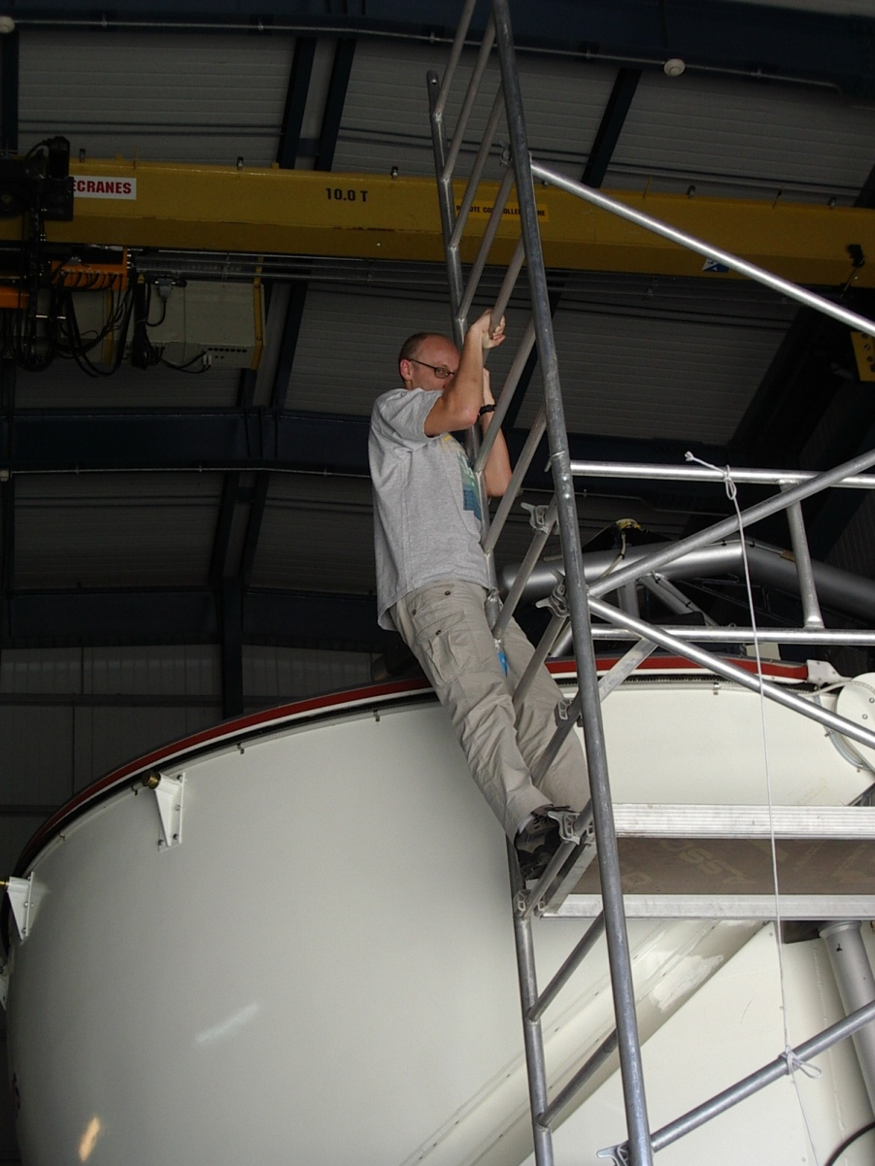
Who is Robert?
Studied at Technical University of Vienna
Worked at Siemens Healthcare, Alcatel,
CERN (LHC, LINAC, PS),
NRAO,
ESO (VLT, ALMA, ELT)
JPL (IMCE, TMT, openMBEE)
Member of INCOSE
Member of the OMG SysML Revision Task Force
User of MagicDraw/SysML since 2007

Slide 4
Some System Level Simulation Background I
1990 Geode at Alcatel – Verilog France
Based on SDL'88 (SDL-92, SDL-2000, SDL-2010)
ITU-T (Recommendations Z.100 to Z.106)
Abstract grammar, concrete grammar and a full formal definition, uses ASN.1 data types
Graphical editor, translator between textual representation (SDL-PR) to graphical representation (SDL-GR), semantic checker, simple report generators, some code generation (C).
System is specified as a set of interconnected abstract machines which were extensions of finite state machines (FSM)
openGeode is still around
Notes:
Abstract Syntax Notation One (ASN.1) is a standard and notation that describes rules and structures for representing, encoding, transmitting, and decoding data in telecommunications and computer networking. The formal rules enable representation of objects that are independent of machine-specific encoding techniques.

Slide 5
Some System Level Simulation Background II
1994 Foresight at CERN - Nu Thena Systems
System design environment
Capture system requirements and designs into graphical executable system models.
Models could be analyzed and simulated to ensure requirements correctness
Discrete Event simulator, modeling network communications and distributed computer systems
Underlying language: Mini-Spec (derived from Ada), was especially strong in abstract data types and specification for describing functionality
Graphical means for describing topological information.
Libraries and environments for abstract network architecture simulations.
Sole definer of language features and provider of tools for their respective environment and language variant.
Not around anymore
Notes:
abstract data type (ADT) is a mathematical model for data types where a data type is defined by its behavior (semantics) from the point of view of a user of the data, specifically in terms of possible values, possible operations on data of this type, and the behavior of these operations.

Slide 6
Context and Goals for a Model
A model is used to describe a domain or system under study or to specify a (business, software and/or hardware) system to be built.
Gain system understanding before or while building the system
Capture (high-level) behavior in platform independent models
Analyze how the system model reacts to user interaction or predefined testing data and execution scenarios
Explore desirable and undesirable behaviors of a system
Consistency across different transformed artifacts such as code, documentation, simulation, and analysis
Semantic consistency: the same semantic is used for model simulation, production code, and prototyping

Slide 7
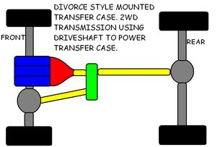
Drawings
Emphasizes presentability and drawing skills
Drawing shows a number of boxes, some with names, some without, and notional connections.
What is the meaning? E.g. are the front wheels and rear the same?
What are the interfaces? How do these interfaces support interaction in the larger whole? What are the properties of the connection (torque) that we care about?

Slide 8
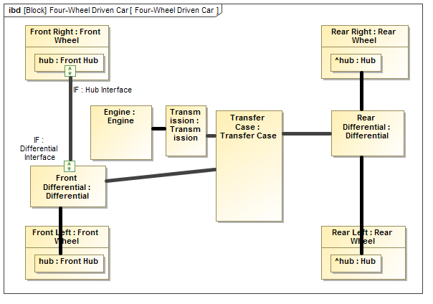
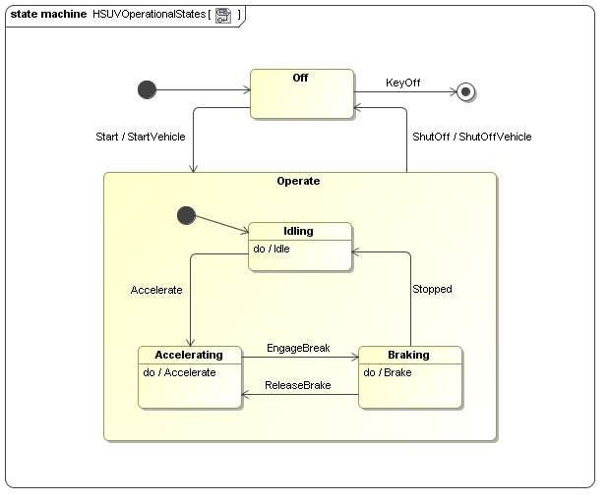
(Executable) Models
Debug the model
Validation, verification of design
Enforce rigorous modeling because semantics must be unambiguous for execution
Big leap in understanding UML came from actually being able to simulate and see what was executable and what was just “boxology”
Code generation, model coverage, model based testing
GUI prototyping allows very early demonstrating behavior
Sacrifice some presentability to get a computable result
Execution Problems
Bug or feature of specification or tool?
User misunderstanding?
Model wrong?

Slide 9
Cameo Simulation Toolkit
Model execution framework and infrastructure:
Model debugging and animation
Pluggable engines, languages and evaluators
User Interface prototyping
Model driven configs and testcases
Open Standards
CAMEO SIMULATION TOOLKIT
9
Notes:
9
Difference to Geode and Foresight

Slide 10
Original Requirements and Current Status
Feb 2008
NoMagic gathering requirements from customers in the following fields:
Integration with 3rd party simulation tool
State chart simulation
Model verification/checking
Model integrity/consistency checking
Data analysis
User Interface prototyping
Code generation from state charts
Test generation from state charts
Languages: OCL, Java, C++, VHDL
-> ESO suggested to use SCXML
May 2015
Pluggable engines, languages and evaluators
Activity execution (OMG™ fUML standard)
State machine execution (W3C SCXML standard)
SysML parametric execution (OMG SysML standard)
Multiple action languages support (JSR223 standard)
Exporting UML state machine to SCXML file format
Full featured model debugger
Execution animation
Quick UI prototyping
Model-driven test cases and scenarios
Notes:
Debugger: Sessions panel, Variables panel, Breakpoints, Animation,
Execution configuration: Some predefined execution settings can be set using model-based execution configuration
Execution trace: DSL for execution trace, All events are recorded

Slide 11
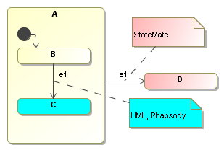
The Standards Story
Problem: Different tools/libraries interpret models differently (CST, JPF, Rhapsody); Different standards have different semantics (OMG vs W3C); UML paper specification going executable (Pretty pictures vs. models)
Context: Model reuse (Simulation, Model Checking, Code Generation).
Lessons Learned: Select a (standard) execution semantic and stick to it in the whole tool-chain.

Slide 12
Foundation for Executable UML
OMG RFP for the Semantics of a Foundational Subset for Executable UML Models – Issued April 2005
An executable subset of standard UML that can be used to define the structural and behavioral semantics of systems.
fUML defines a basic virtual machine for the Unified Modeling Language, enabling compliant models to be transformed into various executable forms for verification, integration and deployment.
OMG
OBJECT MANAGEMENT GROUP
fUML
12
Notes:
12
How did the formal methods of the past bring us to UML / SysML?
Did they improve on it?
Simply emerge from communities larger than the specific subgroups working telecom or networking domains?

Slide 13
State Chart XML - SCXML
W3C
Provides a generic state machine–based execution environment based on Harel state charts.
Is able to describe complex state-machines, including sub-states, concurrency, history, time events and more.
Standard requires 2 reference implementations
W3C provides test suite to test compliance with standard
13
Notes:
13

Slide 14
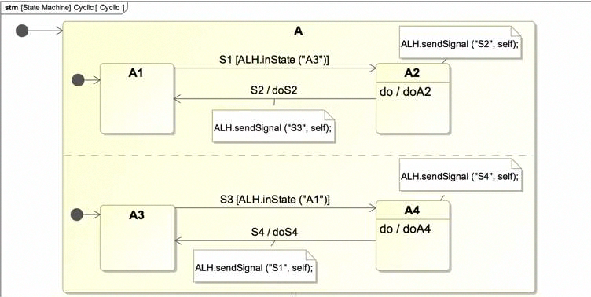
Executable Statecharts

Slide 15
fUML and SCXML integration
The problem:
fUML does NOT support Statemachines
SCXML engine uses SCXML document for execution
The solution:
Implement UML Statemachine to SCXML mapping
SCXML engine is wrapped into fUML interfaces
fUML engine is wrapped into SCXML interfaces
The result:
Engines are independent, integration is part of the toolkit
Statemachine in CallBehaviorActions
Activities or OpaqueBehaviors as entry/do/exit behaviors of the State
SendSignalAction can trigger Transitions in the Statemachine
UML Statemachine can be exported to SCXML file
15
Notes:
15

Slide 16
The CST Alpha phase
May 2010 Alpha 1
Supported on MD 16.8
File based fUML engine
No support for elements not in fUML specification
September 2010 CST 1.0 alpha2
Internally refactored, new fUML engine, API based
Run from within MD
No validation, no documentation
Java exceptions rule
In the beginning a lot of work to setup simulation (e.g. readself, start activity, etc.); now it is easy (e.g. automatic start, no instances necessary)
Turning (f)UML into practice, make it usable
First training at ESO Oct 2010 – already impressive but not robust enough

Slide 17
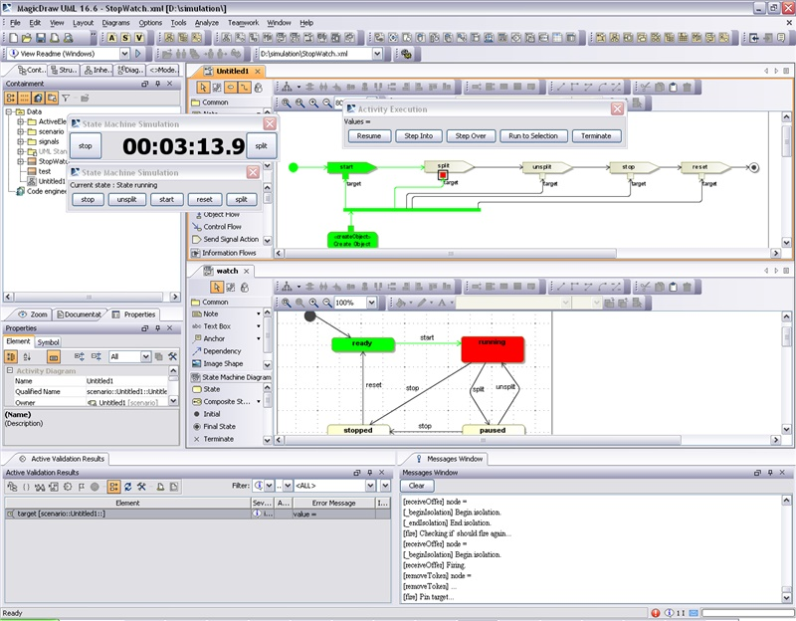
The Beginnings
No simulation window
Triggers are buttons
No debugger
No Variables

Slide 18
A few selected feed backs on Alpha
Model time vs real time
Validations suites for SCXML, f-UML
Snapshots of simulation state
Define input trajectories to simulation
Table representation of instance specs
Action language
Execution of multiple diagrams in same name space
User to select context for execution
Syntax check of constraints
Distinction decision/join nodes
Support SysML value types
Execution without animation
Model Debugger

Slide 19
The Ticket Story
205 MD tickets 2009-2014 (total of 2048 for all customers) plus a lot of inspiring discussions
59 CST tickets (out of 115 total) - all solved First on Nov 2010 on v1.1, internal development system ticket SIM-272 -> implemented in Jan 2015 in v18.1! ☺
Found tricky problems in large models, hard to track down where the problem was, created many small examples to isolate the problem and distinguish between bug and lack of understanding – feedback to vendor is worthwhile!
Robustness vs. New Features trade off
Discovered some critical bugs beginning 2013 – since that a stable product

Slide 20
Cruise Control Story
Modeling for control systems with collaborating state machines
Demonstrate integration of state machine, parametric, activity models for car and environment (created November 2011, CST 1.0 SP1 (7))
Extend action language handler - ALH
Properly handle context in nested STM activities, fUML, SCXML integration
Enable simulation of partially specified models (missing pins, no call behavior, etc.)
Challenges with multiplicities in expressions and constraint parameters
-> Auto triggering of parametric execution
-> support signal exchange over ports and connectors for encapsulated behavior
-> Record and Replay of interaction diagrams

Slide 21
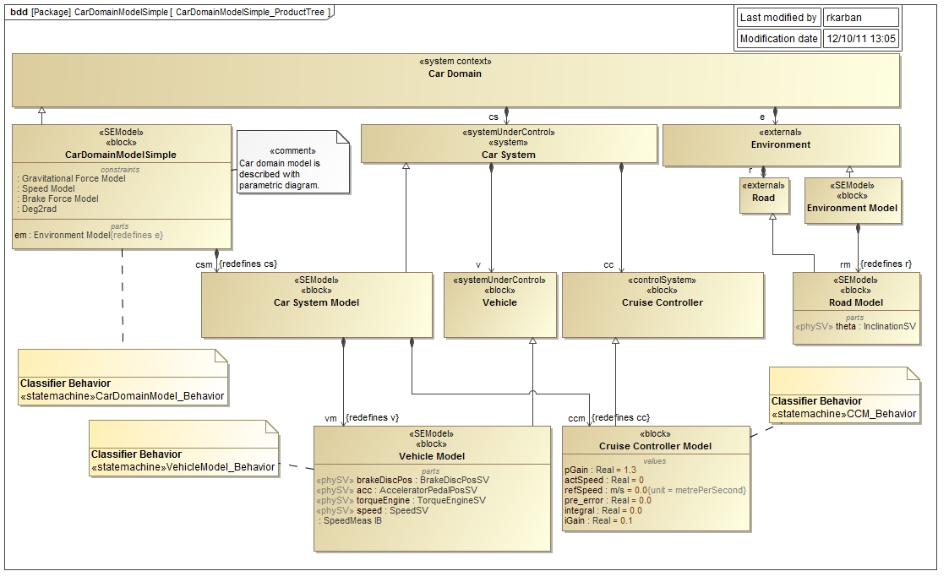
Cruise Control

Slide 22
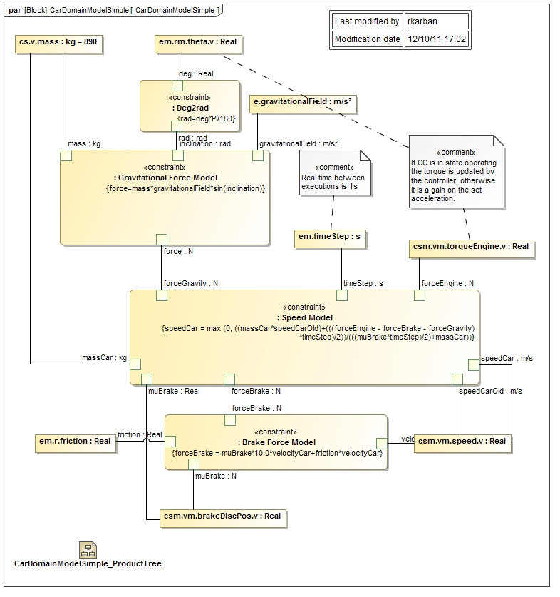
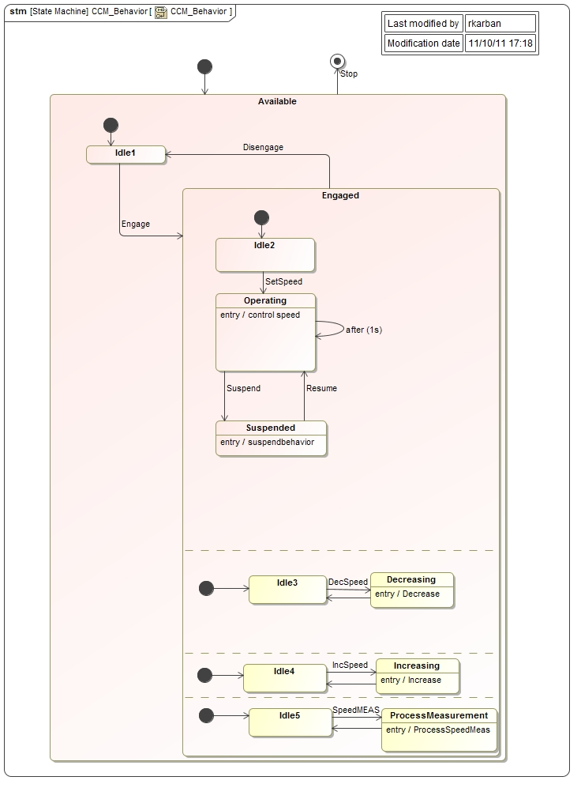
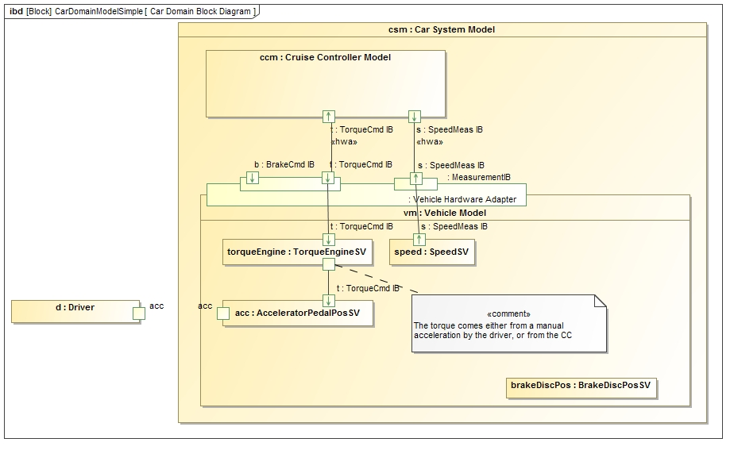
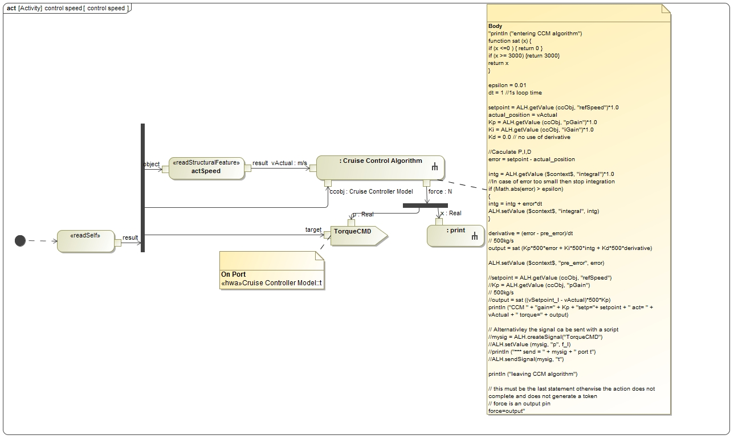
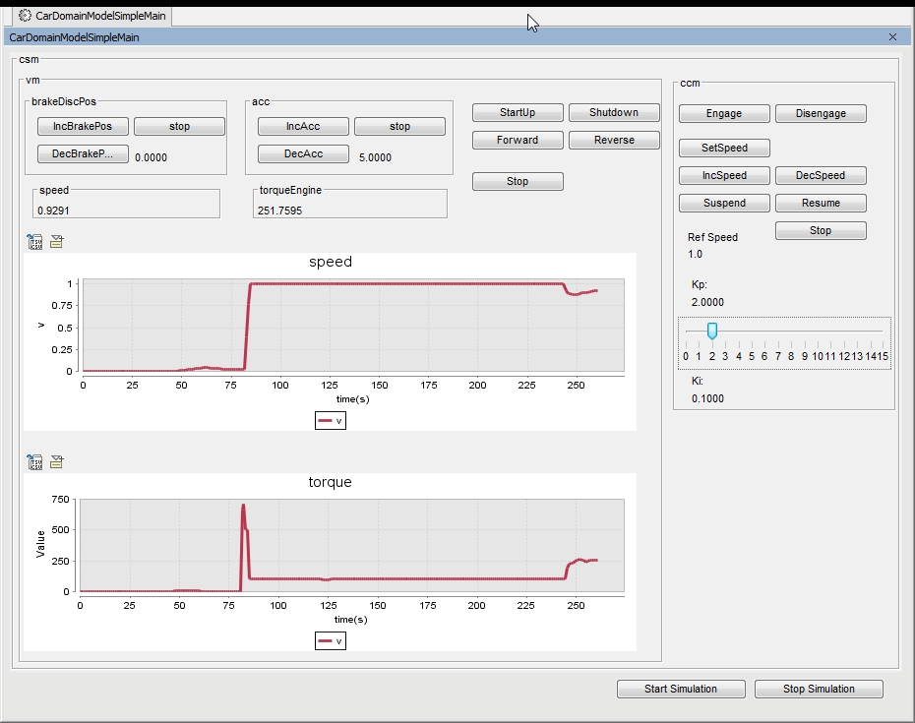
Cruise Control: Behavioral Integration

Slide 23
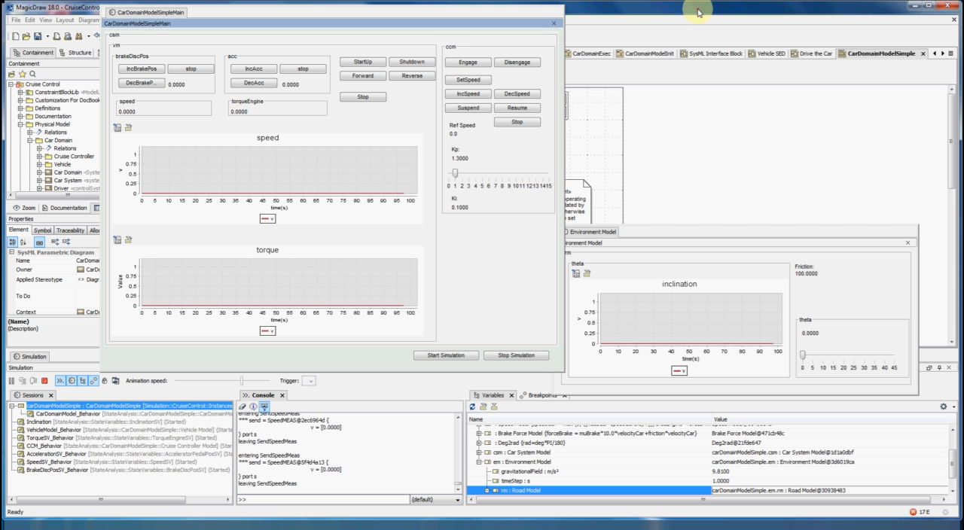
Cruise Control Demo

Slide 24
Time Story
Model time vs. PC Time
Model based time (synthetic clock)
Time stepped debugging
Duration modeling
Analysis of constrained elements

Slide 25
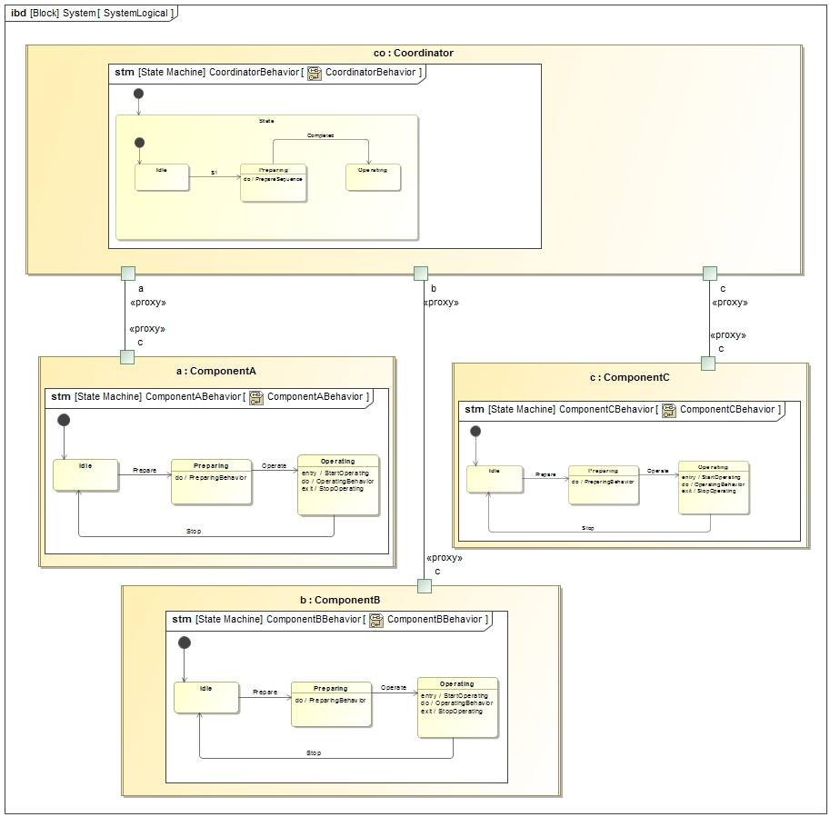
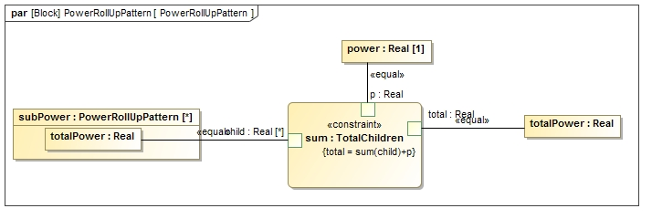
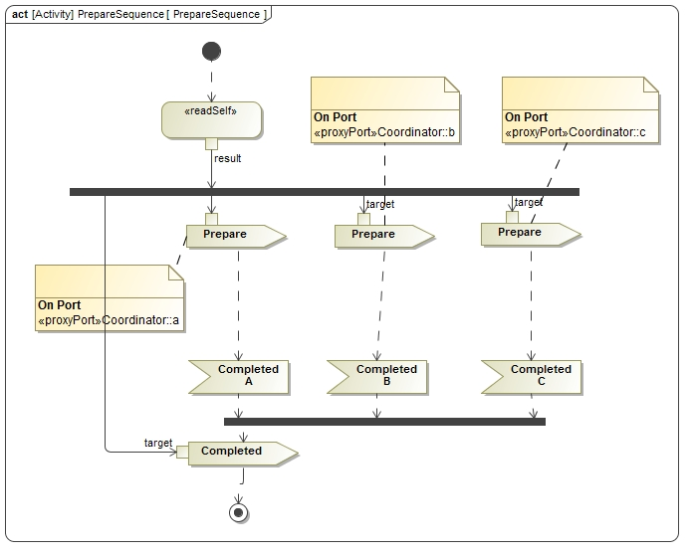
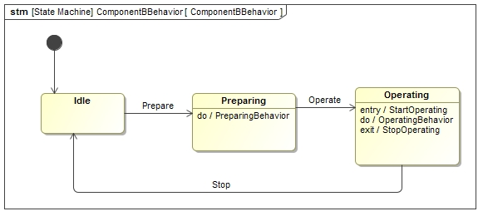
Dynamic power rollup with collaborating state machines
Credit to Nerijus for original idea

Slide 26
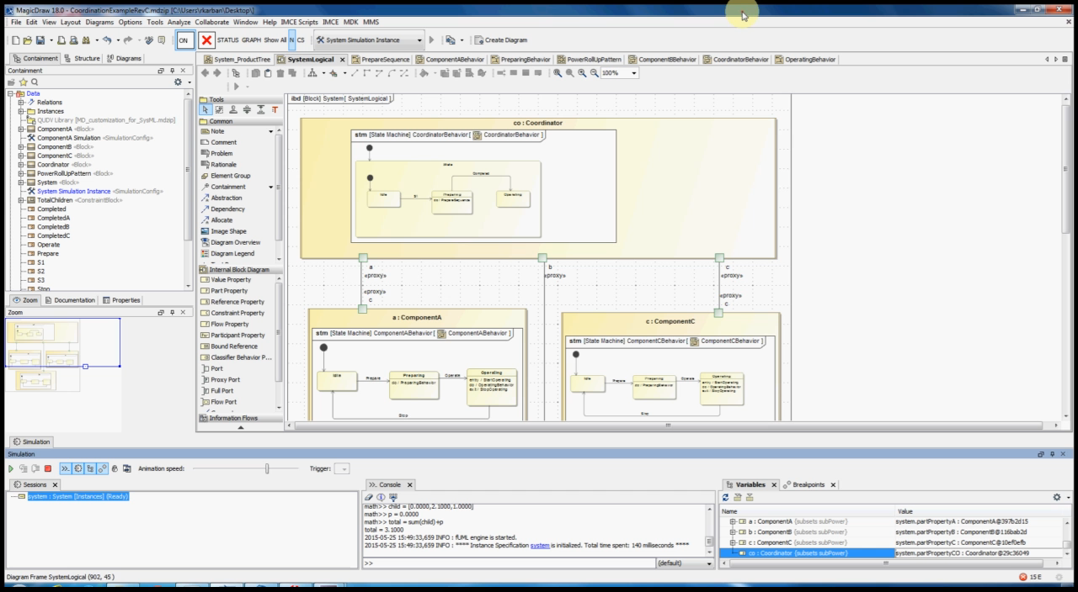
Dynamic power rollup with collaborating state machines - Demo

Slide 27
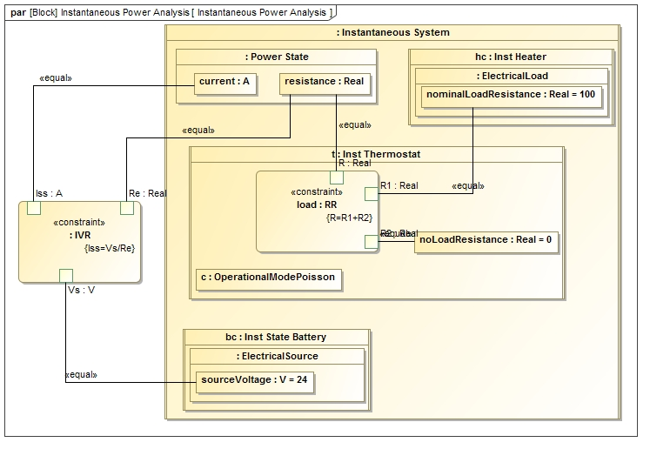
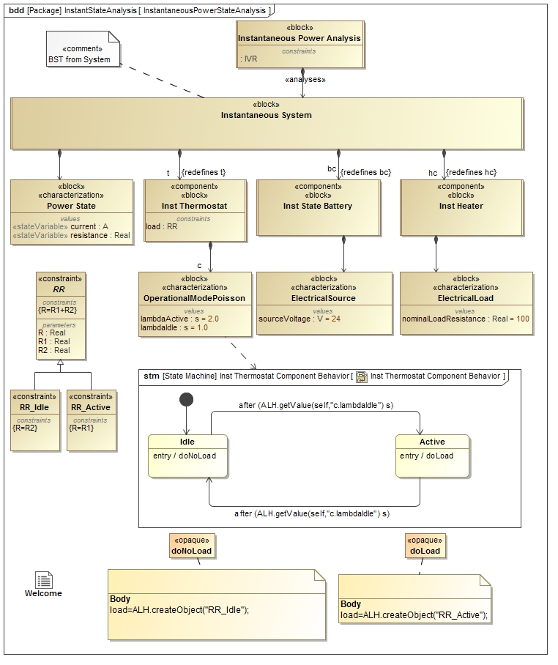
Dynamic change of constraints @runtime
Constraint in parametric model
changes with state change
Credit to Nerijus for original idea

Slide 28
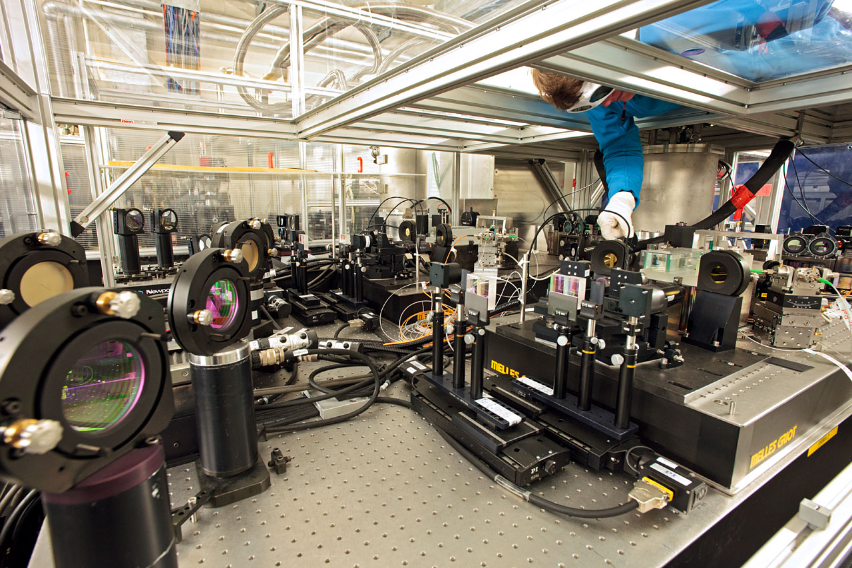
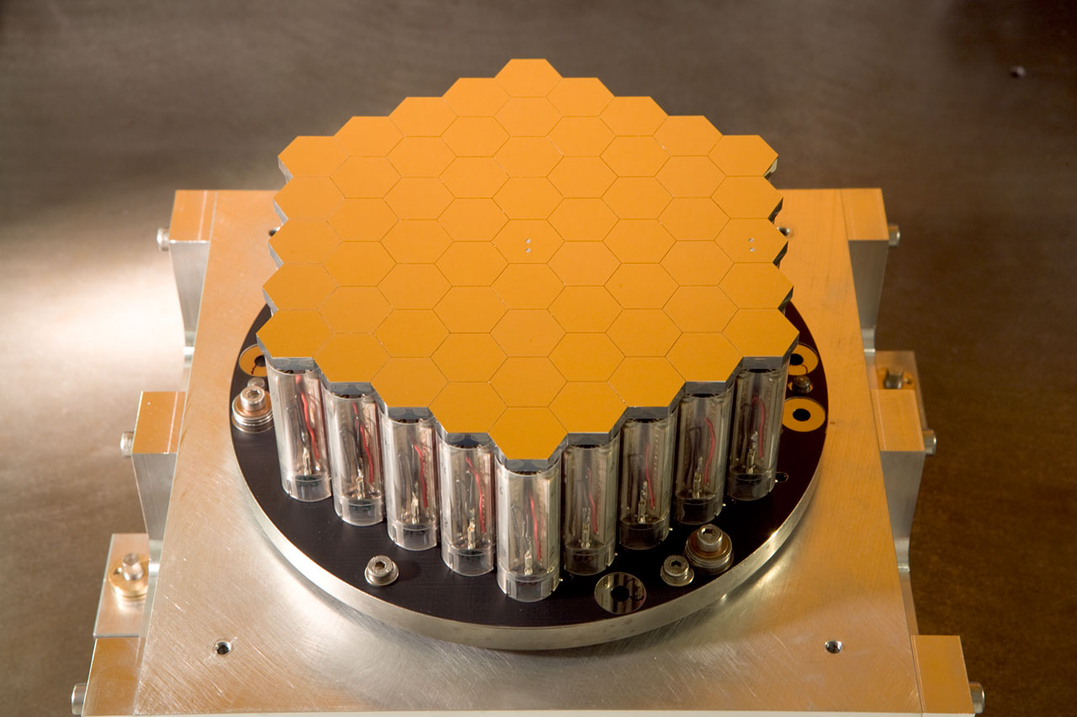
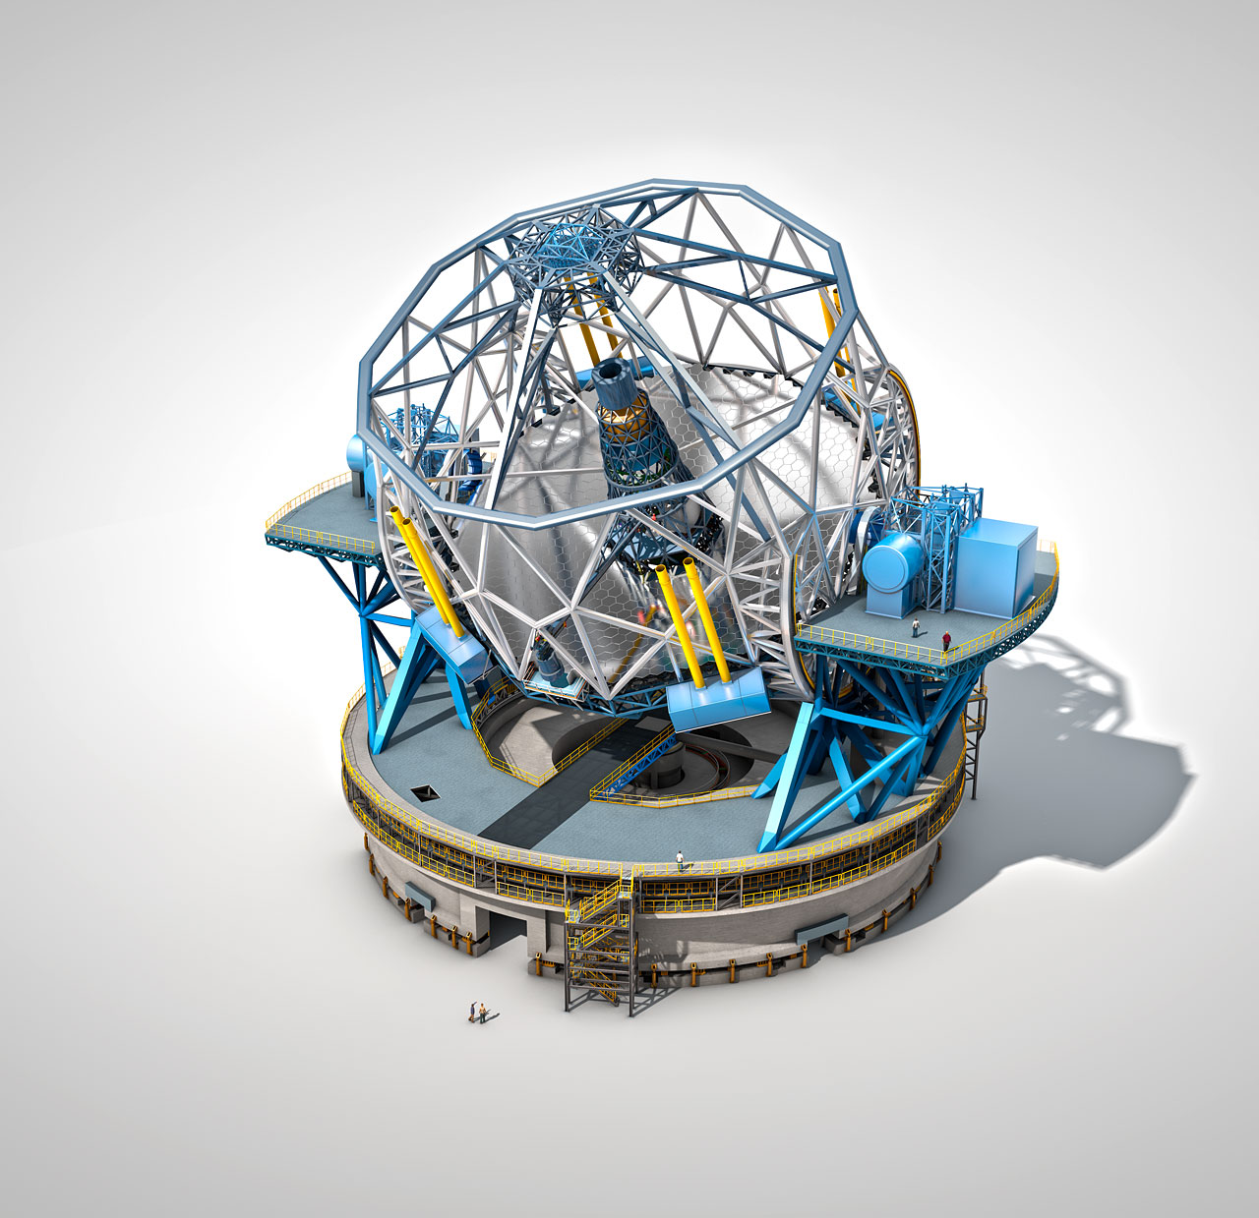
ESO Applications
PRIMA
Auto-code generation
10 Components
States: 252
Transitions: 864
APE
Auto-code generation
11 Components
States:432
Transitions:1260
ELT
High level operations
17 Components
States: 34
Transitions:57
Activity elements: 340
Notes:
PRIMA, APE many states and transitions because productions code is generated from model

Slide 29
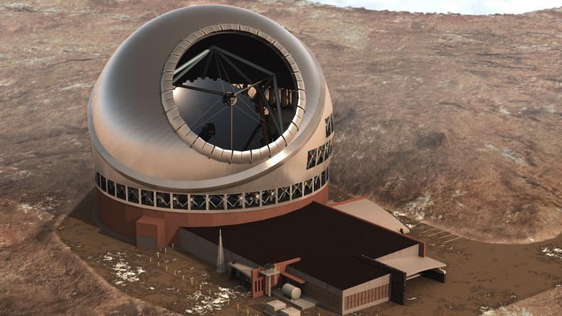
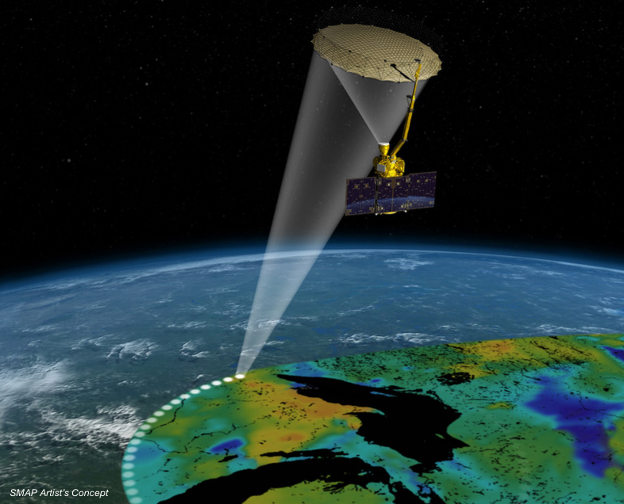
JPL Applications
Thirty Meter Telescope APS
16 Components
States: 62
Transitions: 116
Signals: 100
Activity elements: 432
Duration constraints: 64
SMAP satellite
Modeling Fault Protection
40 Components
States: 2000
Transitions: 3000
Parallel regions: 600
Signals: 500

Slide 30
TMT Motivation, Goals, Problems to solve
Capture APS use cases, e.g.
Post-segment exchange alignment
Alignment maintenance
Phase M1
Off-Axis measurements of WFE
Identify involved subsystems, e.g. TCS, M1CS
Identify interfaces and interactions among subsystems
Analyze associated scenarios
Ensure timing requirements are met
Develop/refine timing requirements for algorithms, ICS and external interface commands

Slide 31
TMT Alignment and Phasing System Modeling
Capture relevant information in a SysML model (database):
Involved subsystems and their interaction points
Information exchanged
Estimated or required time durations of activities
Distribution of system elements, mimic message exchange
Used SysML constructs
Internal Block diagrams, State Machines, Activity Diagrams
Simulate scenarios using executable models based on fUML and SCXML semantics and a model based clock and duration constraints
Confidence of correctness achieved by
Recording traces of simulation in sequence diagrams
Ensure all “leaf” actions have durations constraints applied
Ensure that all actions have been reached in the different scenarios
Evaluate timing against formal constraints

Slide 32
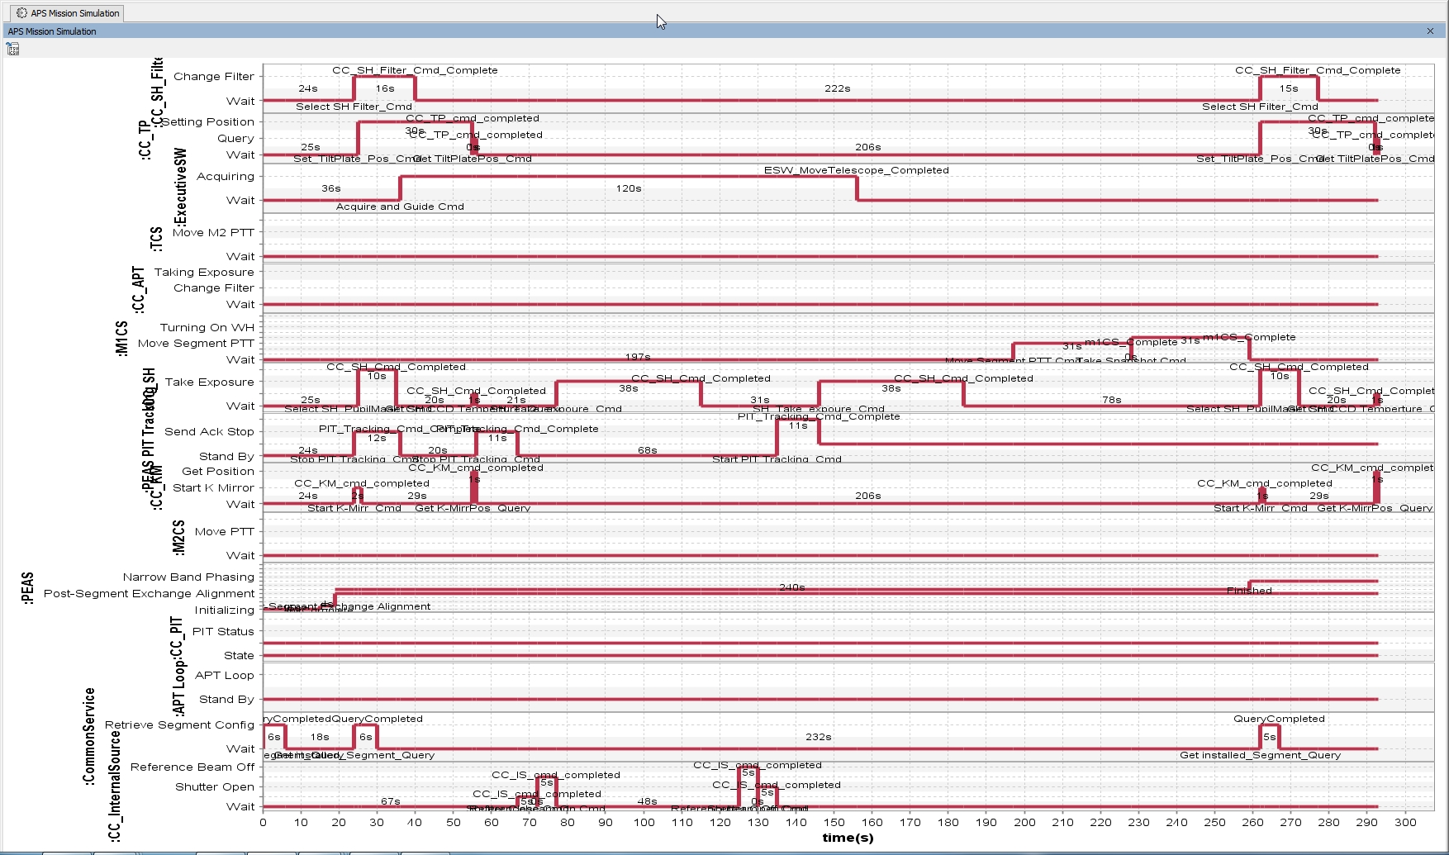
Sample TMT timeline

Slide 33
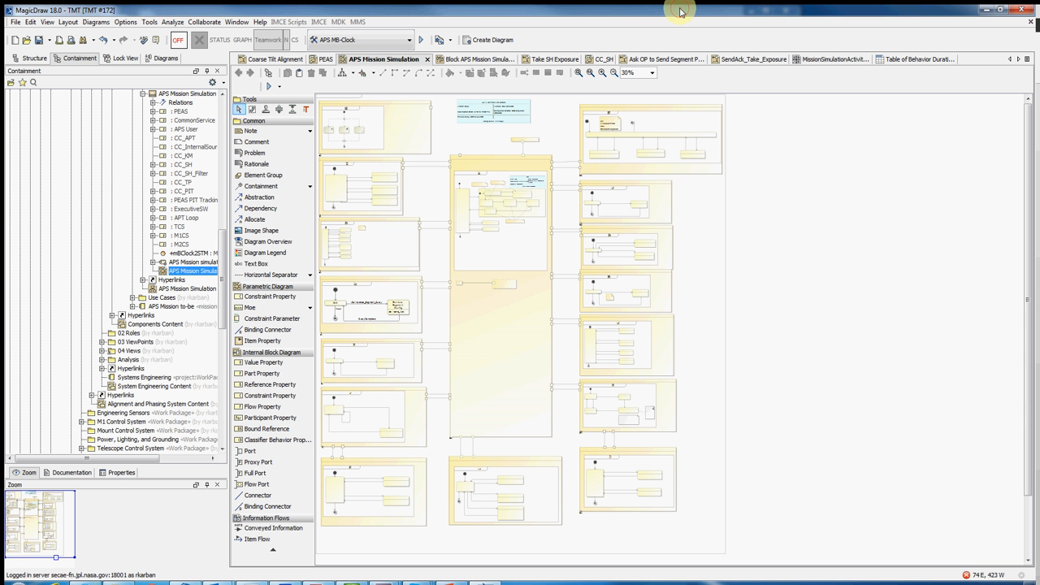
TMT Demo

Slide 34
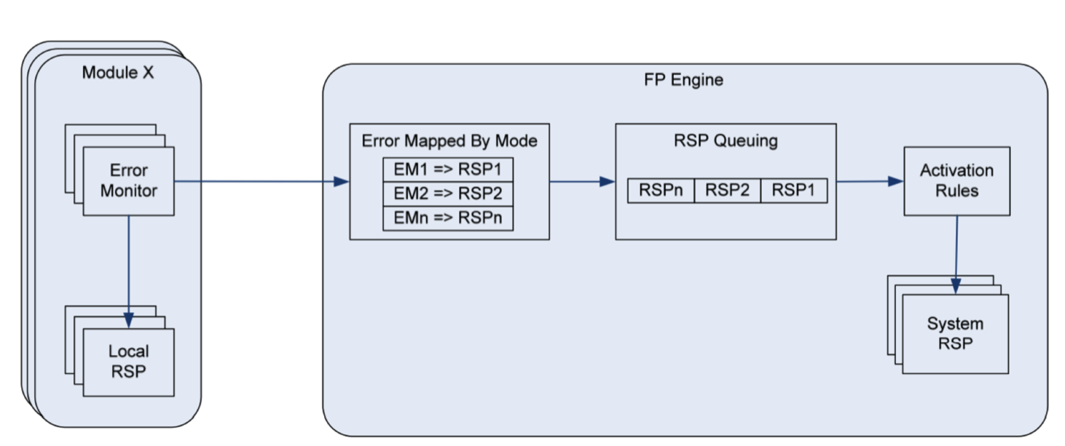
SMAP General Fault Protection Architecture
Formally Define Fault Protection Behavior in Model

Slide 35
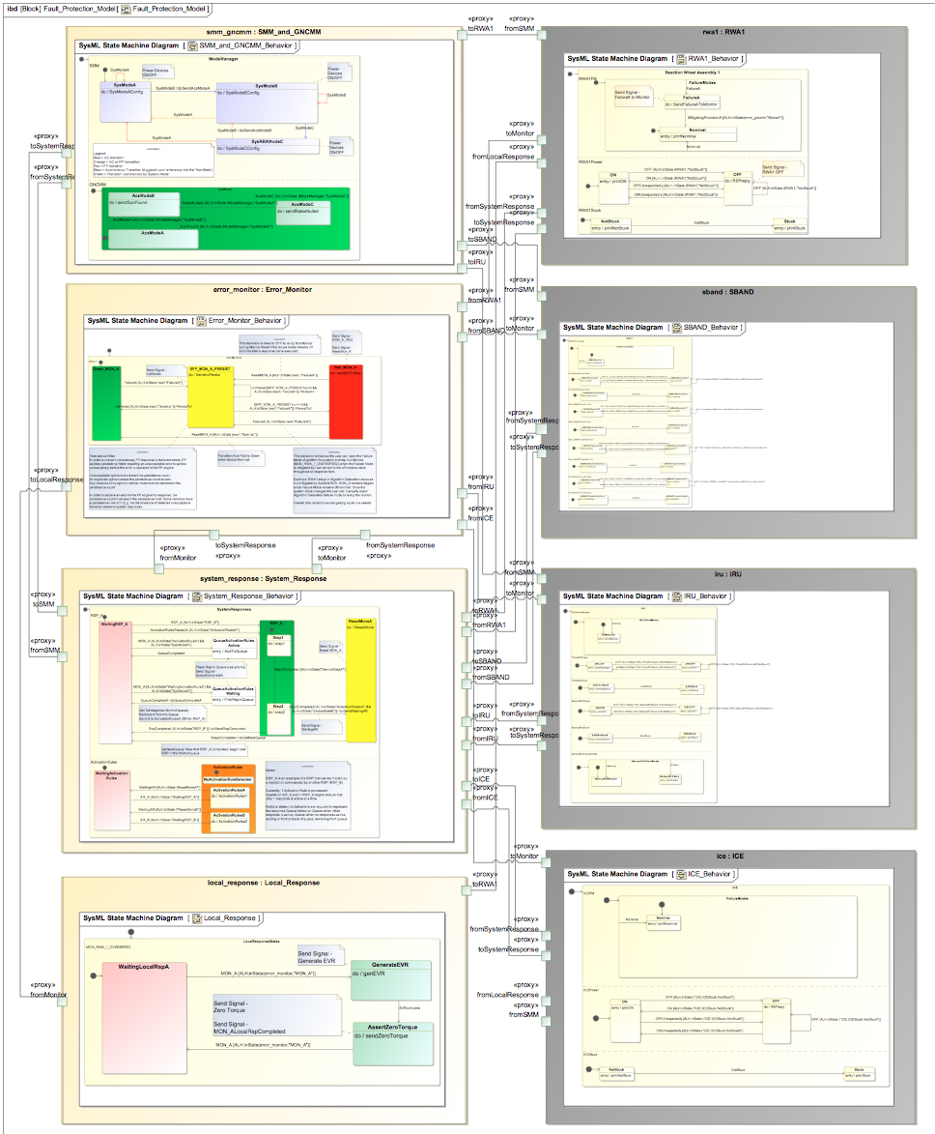
Exemplar Fault Protection Behavior Model
Executable and Model-Checkable Statechart model
Represents subset of Fault Protection logic for the JPL Soil Moisture Active Passive Satellite (launched Feb 2015)
Basic SCXML-compliant statechart patterns captured even the most complicated Fault Protection logic
Mode
Manager
RWA
Error Monitor
IRU
Fault Protection Engine
FSM
35
Local Responses
SBAND

Slide 36
Advantages of Fault Management Behavior Model
Reduces risk of gaps in Fault Protection
Setting up for early verification of Fault Protection behavior
Fault Protection design references/links to other parts of system model
Enables model-based analysis
Enables verification of the implementation
Enables traceability & completeness
Fault Protection Analysis becomes cheaper with tools to
automatically generate reports
execute the model
validate the model
Simulate to Verify Correctly Modeled Behaviors

Slide 37
Automatic Generation of Sequence Diagram
Execution tool outputs text log and visual sequence diagram for post-run behavior verification
Goal is to run a handful of test cases for the different failure modes
Verify that the correct responses that occur and that proper actions were taken to mitigate the fault
Note: Not all cases can be simulated (takes too long) & interdependencies of multiple simultaneous fault injections can’t be thoroughly simulated. – This is where model checking excels

Slide 38
Why use CST and what are its Limitations
Early feedback on the logical correctness of the model e.g. in the context of collaborating state machines
Integration of different behavioral specifications
Architectural, high-level operational simulation and analysis
Pluggable architecture
Support of open standards
Apply own transformations to model
Not full SCXML standard supported (Apache engine)
No test suite of fUML implementation provided by OMG
No reference implementation required by OMG
No certification of correctness
No storage of data outside MagicDraw Model
Potential performance issues for large models

Slide 39
Outlook
CAMEO SIMULATION TOOLKIT
Functional Mockup Interface (FMI)
ALF, UML vs SCXML, Precise Semantics for Composite Structures (PSCS)
Store simulation results (sequence diagram recording, instance snapshots, simulation logs) outside system model in dedicated big data repository
Support of existing standards (e.g. ASN.1)
Clocked execution, Server side execution
Integration with model checking tools
Still work ahead for hardcore physical simulation
Performance
Reliably compute technical resource or control margin on a spacecraft
How does a high-level, architectural simulation or play through of key scenarios fit with all of the other available Modeling and Simulation technology?
Potential to use analytical solving and hybrid simulation
Set read-only flag on ports to false if you are think they are broken!
Notes:
Analytical model allows to query the model for different solutions.

